Slide 1
Operations Management and Supply Chain Processes
Dr. Ronald K. Satterfield
Muma College of Business
University of South Florida

Slide 2
Math Optimization I
Dr. Ronald K. Satterfield
Muma College of Business
University of South Florida
Getting the Most for the Least
Or the Least for the Most

Slide 3

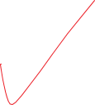




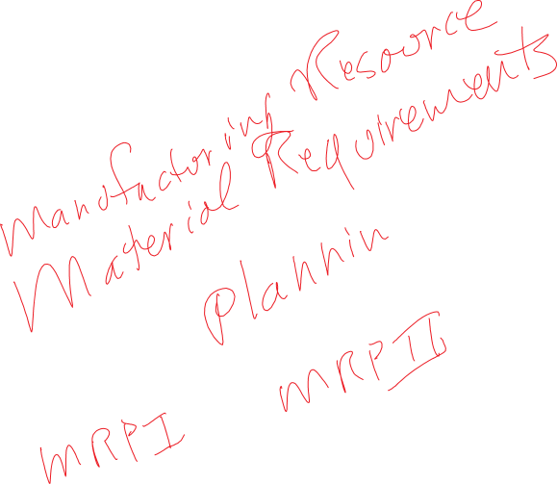

Plan for This Presentation
Introduction to Math Optimization
Fundamental Math Modeling
Formulating a Model
Solving the Model
The Solution Space
Interpreting the Solution
Sensitivity Analysis
Product Mix
Production & Inventory
Blending
Workforce Scheduling
Summary
Your Review

Slide 4
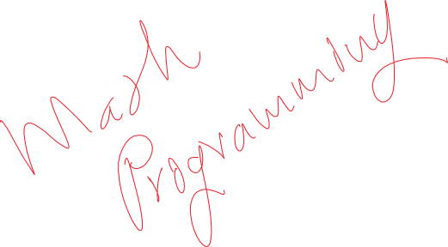




Mathematical Optimization
Area of Quantitative Analysis for “optimizing” a problem.
About 60 years old.
Common today, but not many know about it.
Introduction | Fundamental Modeling | Production & Inventory
Blending | Workforce Scheduling | Summary & Your Review

Slide 5



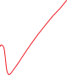
Kinds of Mathematical Optimization
Linear Programming
Integer Programming
Mixed Integer Programming
Goal Programming
Network Modeling
Introduction | Fundamental Modeling | Production & Inventory
Blending | Workforce Scheduling | Summary & Your Review

Slide 6
What is “Solver”?
Third-Party Add-In with Excel
Frontline Systems, Inc. (www.solver.com)
Basic Version Comes Free with Excel (Hobbled)
Complete Capabilities Available for Purchase
Introduction | Fundamental Modeling | Production & Inventory
Blending | Workforce Scheduling | Summary & Your Review

Slide 7

We Use the Hobbled Version
No special software for you to buy
Learn how to use a ubiquitous tool
If the handicaps bother you, the full version is available
Introduction | Fundamental Modeling | Production & Inventory
Blending | Workforce Scheduling | Summary & Your Review

Slide 8

Introduction | Fundamental Modeling | Production & Inventory
Blending | Workforce Scheduling | Summary & Your Review

Slide 9
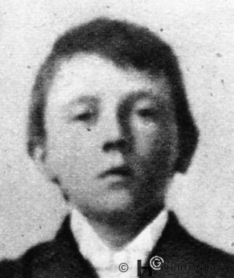
Introduction | Fundamental Modeling | Production & Inventory
Blending | Workforce Scheduling | Summary & Your Review

Slide 10
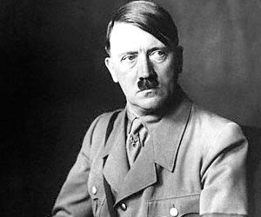
Introduction | Fundamental Modeling | Production & Inventory
Blending | Workforce Scheduling | Summary & Your Review

Slide 11
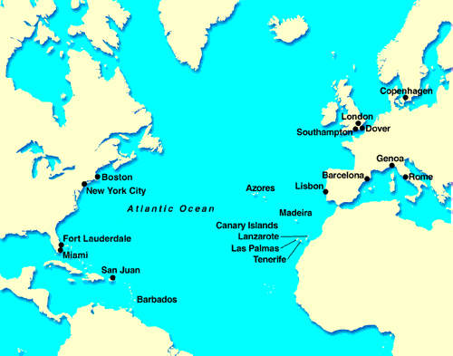







Introduction | Fundamental Modeling | Production & Inventory
Blending | Workforce Scheduling | Summary & Your Review

Slide 12
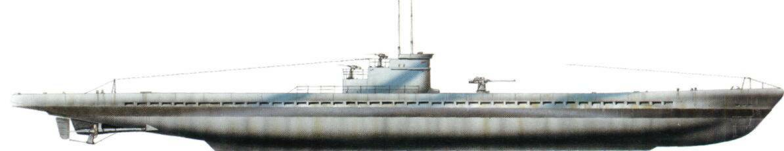
Introduction | Fundamental Modeling | Production & Inventory
Blending | Workforce Scheduling | Summary & Your Review

Slide 13
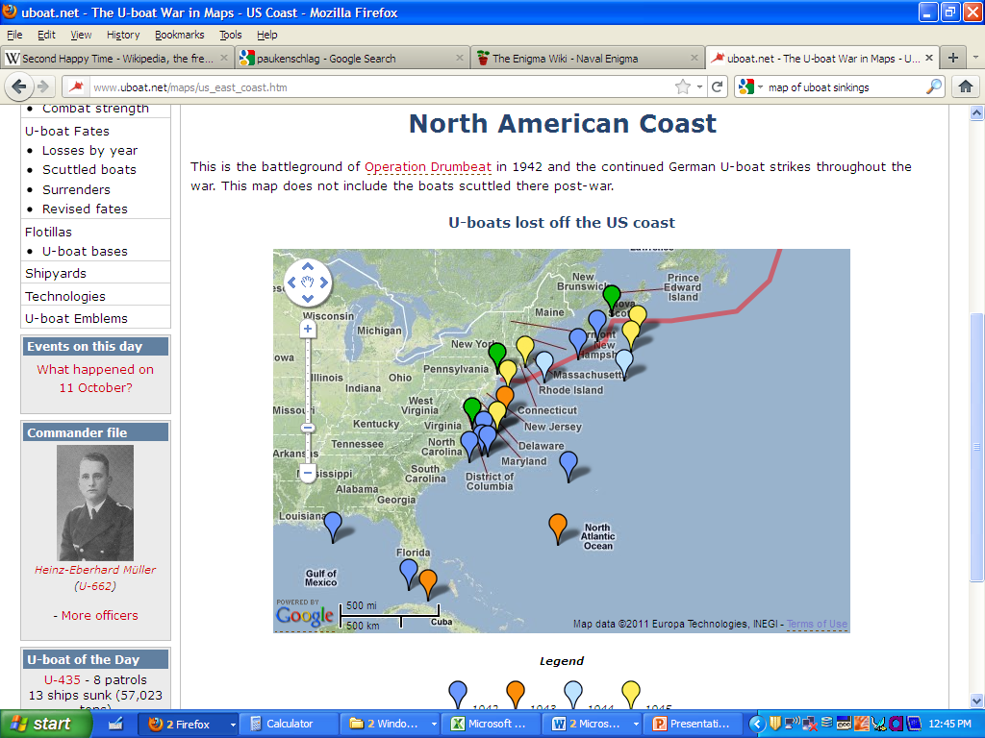
Introduction | Fundamental Modeling | Production & Inventory
Blending | Workforce Scheduling | Summary & Your Review

Slide 14
Two Important Developments
Optimization for Protection & Coverage
Computers for Code Breaking
Introduction | Fundamental Modeling | Production & Inventory
Blending | Workforce Scheduling | Summary & Your Review

Slide 15
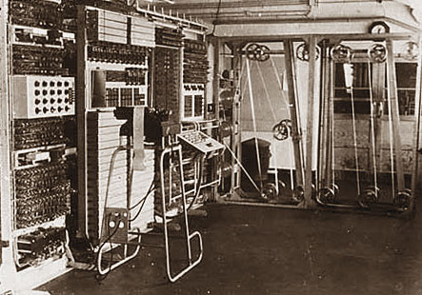
Colossus

Slide 16
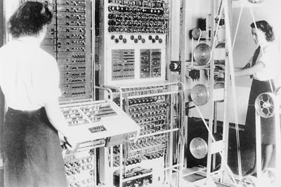
Colossus

Slide 17
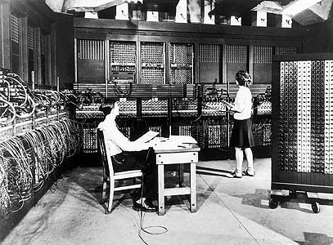
ENIAC
Electronic Numerical Integrator and Calculator

Slide 18
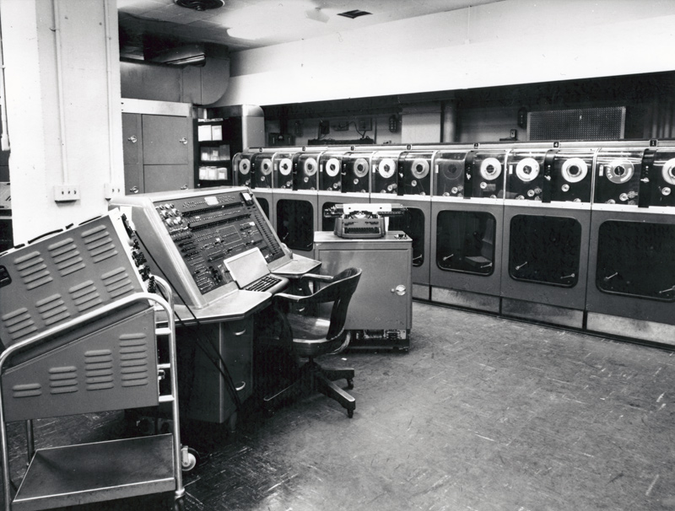
UNIVAC I & II
Universal Automatic Computer

Slide 19
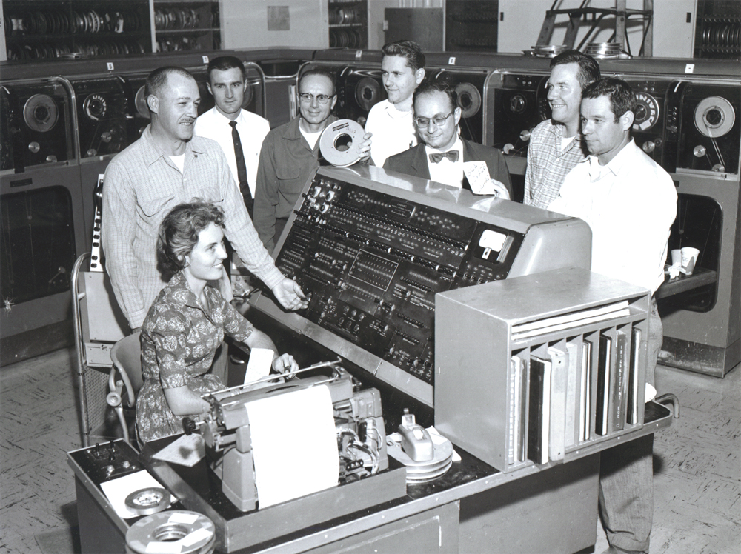
UNIVAC I & II
Universal Automatic Computer

Slide 20
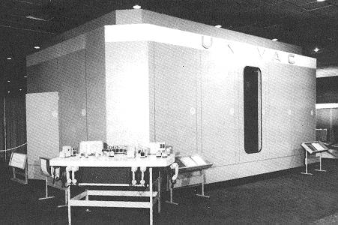
UNIVAC I & II
Universal Automatic Computer

Slide 21
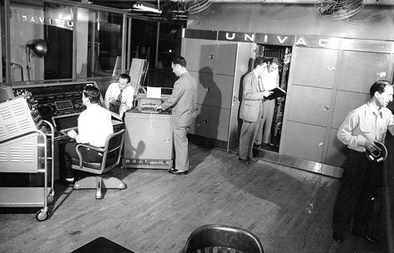
UNIVAC I & II
Universal Automatic Computer

Slide 22
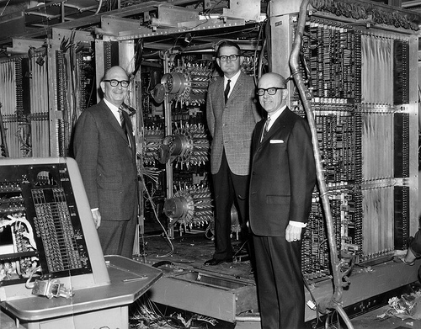
UNIVAC I & II
Universal Automatic Computer

Slide 23
A Mathematical Model
Subject to:
Introduction | Fundamental Modeling | Production & Inventory
Blending | Workforce Scheduling | Summary & Your Review

Slide 24

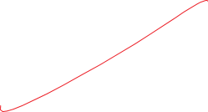
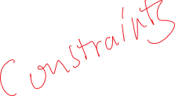

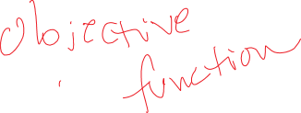











An Example Model
Subject To:
Introduction | Fundamental Modeling | Production & Inventory
Blending | Workforce Scheduling | Summary & Your Review

Slide 25

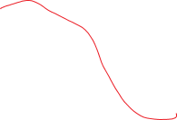
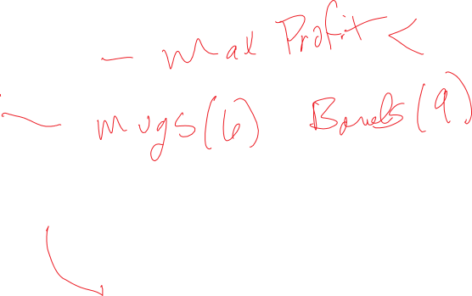
Formulating a Model
What are you trying to achieve
How do you achieve it
How are resources used
What are the resource limits
Introduction | Fundamental Modeling | Production & Inventory
Blending | Workforce Scheduling | Summary & Your Review

Slide 26
Production & Inventory
Introduction | Fundamental Modeling | Production & Inventory
Blending | Workforce Scheduling | Summary & Your Review

Slide 27
Blending
Introduction | Fundamental Modeling | Production & Inventory
Blending | Workforce Scheduling | Summary & Your Review

Slide 28
Workforce Scheduling
Introduction | Fundamental Modeling | Production & Inventory
Blending | Workforce Scheduling | Summary & Your Review

Slide 29
Summary & Your Review
Introduction | Fundamental Modeling | Production & Inventory
Blending | Workforce Scheduling | Summary & Your Review

